Slide 1
Authenticating Users

Slide 2
Today’s Plan
Elements of Authentication (Chapter 6, Elementary Information Security)
Lab 5: Managing users and groups in Linux.
Lab(s) Python: Passwords and Biometrics.

Slide 3
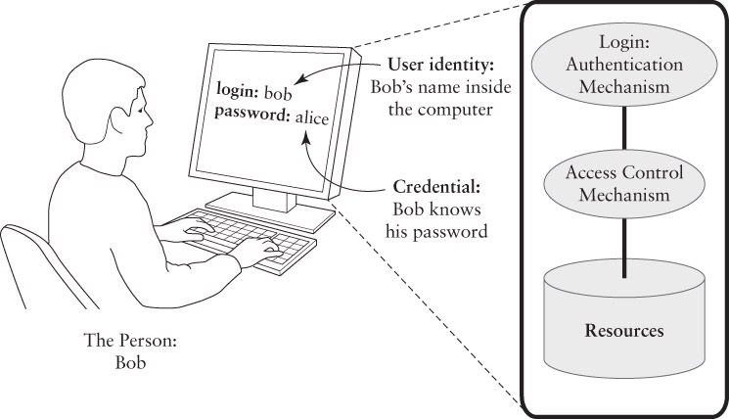
Elements of Authentications
An authentication system makes it as hard as possible for one user to masquerade as another by forging a credential.

Slide 4
Authentication Factors
Something you know
Password, pin
Something you have
Key, token
Something you are
Biometric measure, personal trait

Slide 5
Other authentication factors?
Something you can do, e.g. accurately reproducing a signature or speak.
Something you exhibit, e.g. a particular personality trait, or even neurological behaviour that could be read by an fMRI. These are not strictly "are" features, as they're more fluid.
Somewhere you are (or have access to), e.g. locking a session to an IP, or sending a confirmation pin to your address. This one is a bit tenuous in terms of being called an authentication factor, but it's still useful to note.
Adding more really helps?

Slide 6
Multi-Factor Authentication
Using different factors, not multiple instances of the same factor
Follows the defence-in-depth best practice principle:
Checkpoints are added for authentication and authorisation.
Examples: ATM, Biometric laptops, Biometric cards.

Slide 7
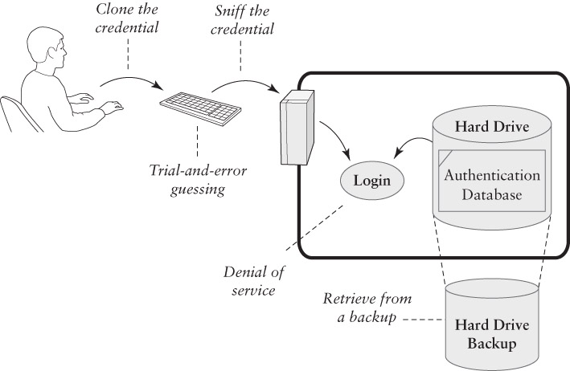
Attacks on Authentication

Slide 8
Passwords
Something you know

Slide 9
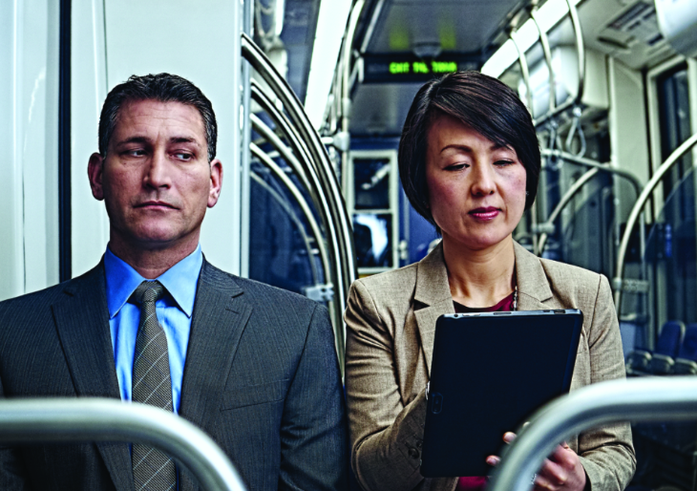
Password Authentication
Each User ID is associated with a secret:
User presents the secret when logging in.
System checks the secret against the authentication database.
Access granted if the secret matches.
Risks:
Shoulder surfing at the keyboard.
Reading the password off of printer paper.
Sniffing the password in transit or in RAM.
Retrieving the authentication database.

Slide 10
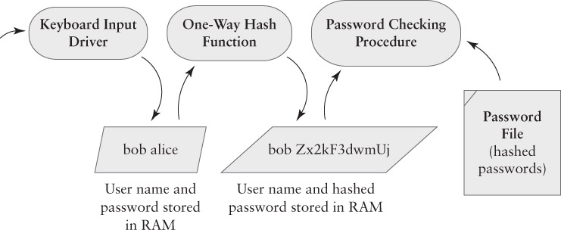
Password Hashing

Slide 11


The crypt() algorithm
$$\}$$
root:x:0:1:System Operator:/:/bin/ksh
daemon:x:1:1::/tmp:
uucp:x:4:4::/var/spool/uucppublic:/usr/lib/uucp/uucico
rachel:x:181:100:Rachel Cohen:/u/rachel:/bin/ksh
arlin:x.:182:100:Arlin Steinberg:/u/arlin:/bin/csh
walt:fURfuu4.4hY0U:129:129:Belgers:/home/walt:/bin/csh
System accounts
$$\}$$
User accounts
Random
salt
(12-bit number [0,4’095])
cleartext
(64-bit blocks)
key (56-bit key = 8*7-bit ASCII characters)
25x Data Encryption
Standard (DES)
ciphertext
Notes:
-25x DES is repeated 25 times

Slide 12
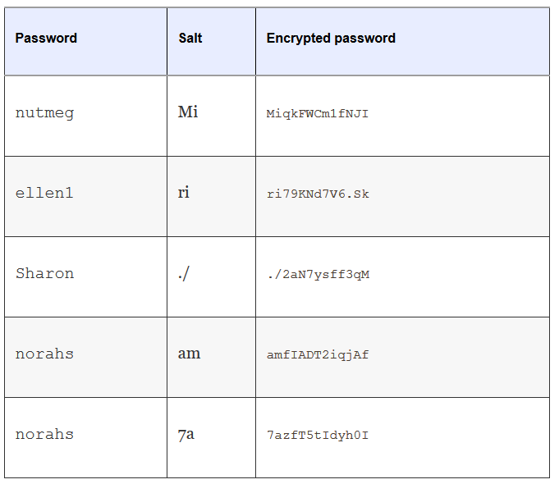
Examples of “salted” passwords

Slide 13
Pros and Cons of Classical Salt
The same password can be encrypted in 4,096 different ways.
This makes it much harder for an attacker to build a reverse dictionary for translated encrypted passwords back into her unencrypted form:
To build a reverse dictionary of 100,000 words, an attacker would need to have 409,600,000 entries.
With 8-character passwords and 13-character encrypted passwords, 409,600,000 entries fit in roughly 8 GBs of storage.
Error in implementation:
Many systems selected salt based on the time of day, which made some salts more likely than others.

Slide 14
Solutions
Adopting other encryption methods (i.e. Blowfish, MD5, SHA).
Add more characters for passwords and more salt variety.
crytpt16(): Increase DES rounds.
Modular Crypt Format (MCF): Extensible scheme for formatting encrypted passwords.
$1$EqkVUoQ2$4VLpJuZ.Q2wm6TAiyYt75.
$5$rounds=535000$h84dK.$eTIcudqFuA7bfMQza61WMQ73WtvkLmjbfsdOnKaSRj/

Slide 15
Sniffing Passwords
Goal: intercept the password before it is hashed.
Keystroke loggers
In Hardware: devices that connect to a keyboard’s USB cable.
In Software: procedures that eavesdrop on keyboard input buffers.

Slide 16
Password Guessing
DoD Password Guideline (1985) required a minimum 1 in a million chance of successful guessing.
This was designed to defeat interactive password guessing: a person or machine made numerous guesses.
Some guessing succeeds based on social and personal knowledge of the targeted victim.
Modern network-based guessing can try tens of thousands of alternatives very quickly.
Examples: John the Ripper, hydra, medusa, ophcrack, rainbowcrack, ssh bruteforce, etc…

Slide 17
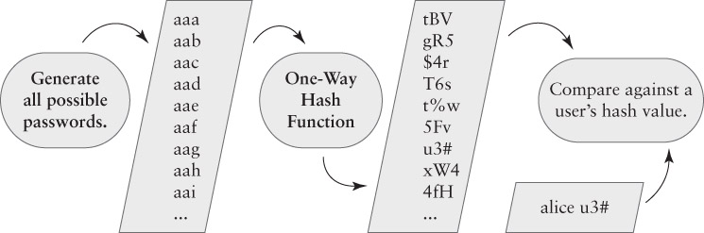
Offline Password Cracking

Slide 18
How fast it is?
It depends on the size of the search space.
How many valid or likely passwords are there?
Valid passwords are limited to specific sets of characters, typically from the ASCII set.
Two letter passwords = 26²
Three letter passwords = 26³
Password with L letters = 26^{L}

Slide 19
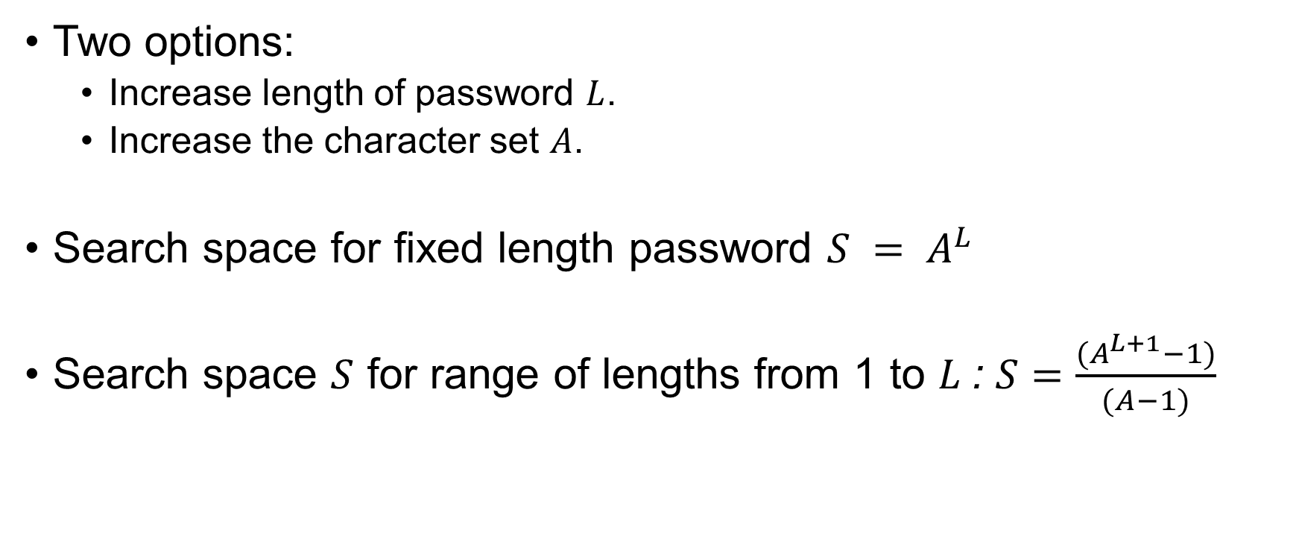
Increasing the search space
Two options:
Increase length of password $L$.
Increase the character set $A$.
Search space for fixed length password $S = A^{L}$
Search space $S$ for range of lengths from 1 to $L$: $S=\frac{(A^{L+1}−1)}{(A−1)}$

Slide 20
Reducing the search space
Attacker does not try every possible password!
Restricts the search space to likely passwords:
Morris worm successfully used this attack.
A dictionary attack
Uses a list of likely passwords as the password space.
There are far fewer likely passwords than possible passwords.

Slide 21
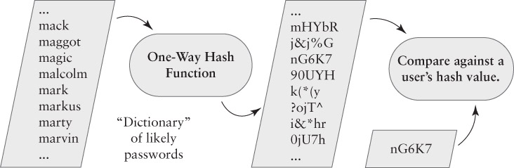
Dictionary Attack

Slide 22
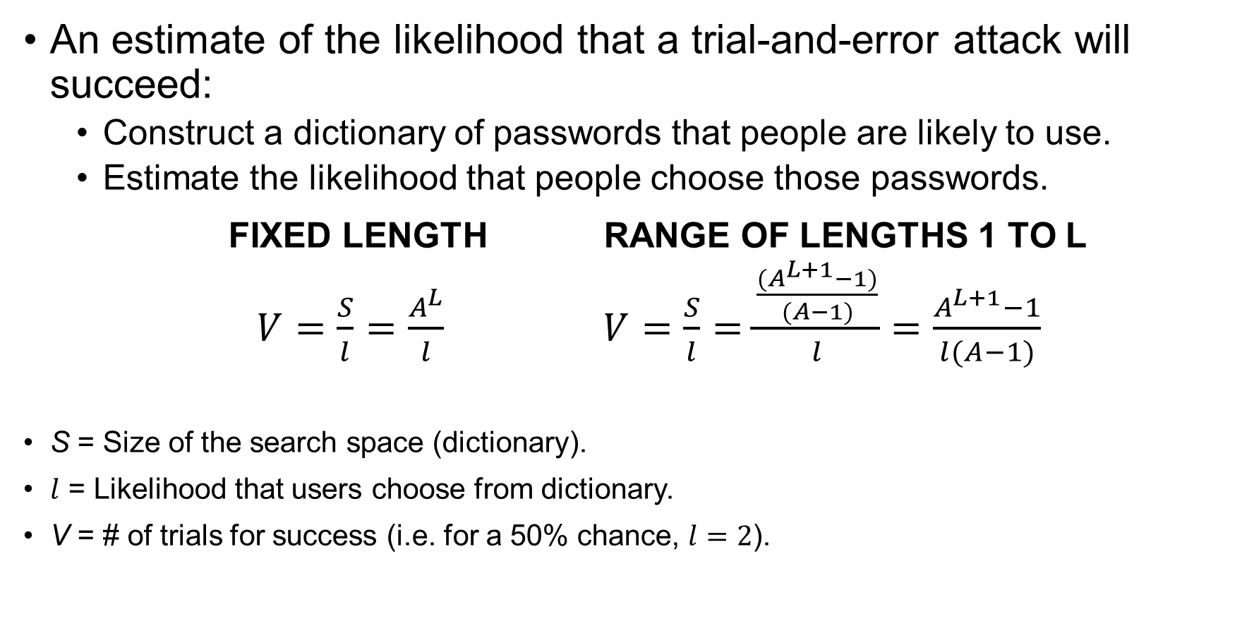
How fast is it?
An estimate of the likelihood that a trial-and-error attack will succeed:
Construct a dictionary of passwords that people are likely to use.
Estimate the likelihood that people choose those passwords.
FIXED LENGTH RANGE OF LENGTHS 1 TO L
$V=\frac{S}{l}=\frac{A^{L}}{l}$ $V=\frac{S}{l}=\frac{\frac{(A^{L+1}−1)}{(A−1)}}{l}=\frac{A^{L+1}−1}{l(A−1)}$
S = Size of the search space (dictionary).
$l$ = Likelihood that users choose from dictionary.
V = # of trials for success (i.e. for a 50% chance, $l=2$).

Slide 23
Tokens
Something you have

Slide 24
Pro’s and Con’s
Benefits
Hard to attack - uses a stronger secret than you get in a typical password.
Hard to forge - must hack the hardware.
Hard to share – secret stored in hardware.
Problems
“Expensive”.
Can be lost or stolen.
Risk of hardware failure.
Risk of battery loss.

Slide 25
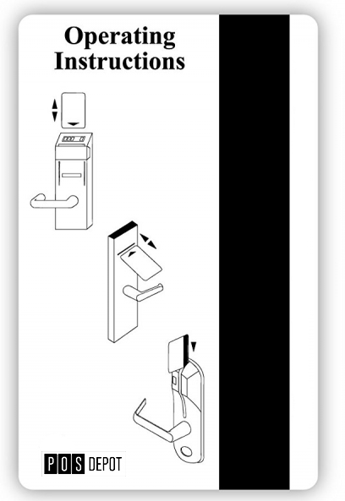
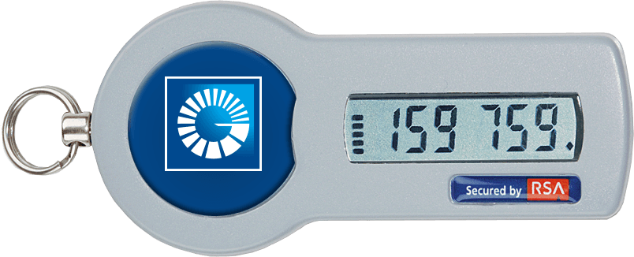
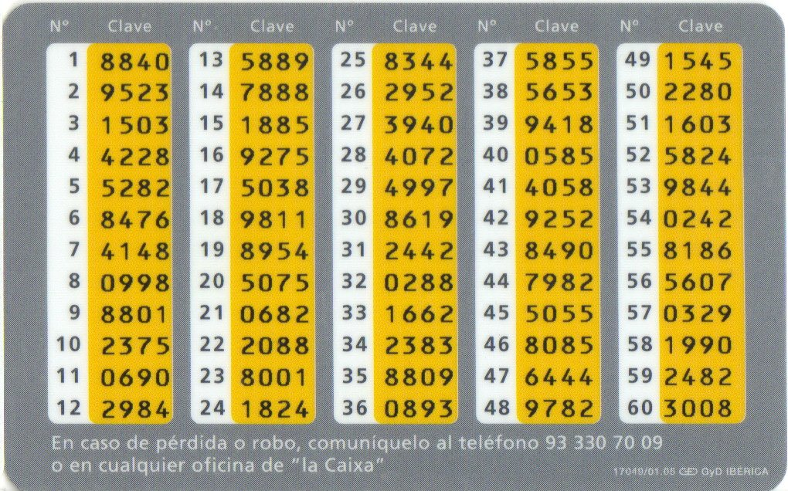
Types of Tokens
Passive Tokens
Stores an unchanging credential.
Example: card keys for hotel rooms.
Active Tokens
Stores a secret that generates a different credential for each login
Example: one-time password tokens.

Slide 26
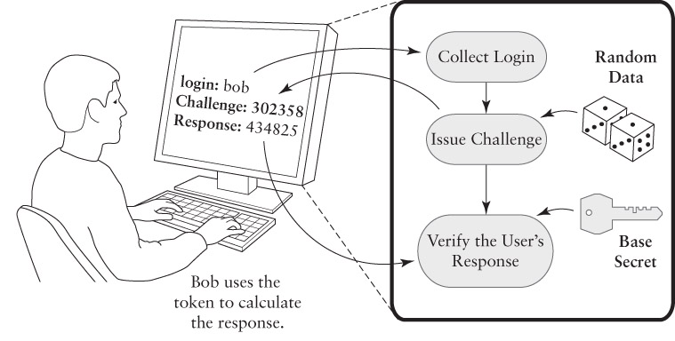
Challenge Response Authentication

Slide 27
Challenge Response Authentication
Challenge Response Authentication is a protocol.
An exchange of data to yield a shared result.
Four steps:
Bob says, “Authenticate me”.
Alice says, “The challenge is 56923”.
Bob calculates the response and says, “The response is 17390”.
Alice checks Bob’s response against what she expected, using the same calculation.
Calculation relies on a shared secret.

Slide 28
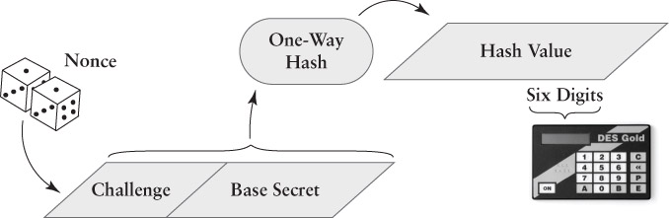
Challenge Response Authentication

Slide 29
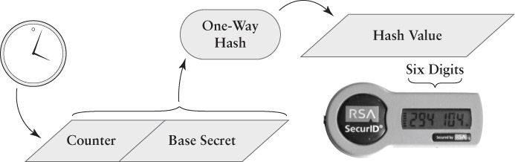
One-time Password Token

Slide 30
Biometrics
Something you are

Slide 31
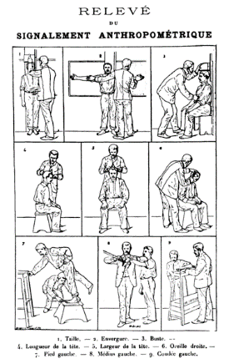
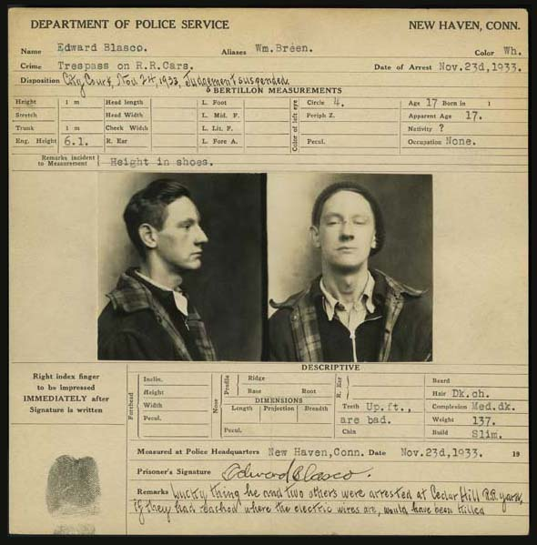
Bertillion System of Criminal Identification
Notes:
Bertillon's Identification anthropométrique (1893), demonstrated the measurements needed for his anthropometric identification system.

Slide 32
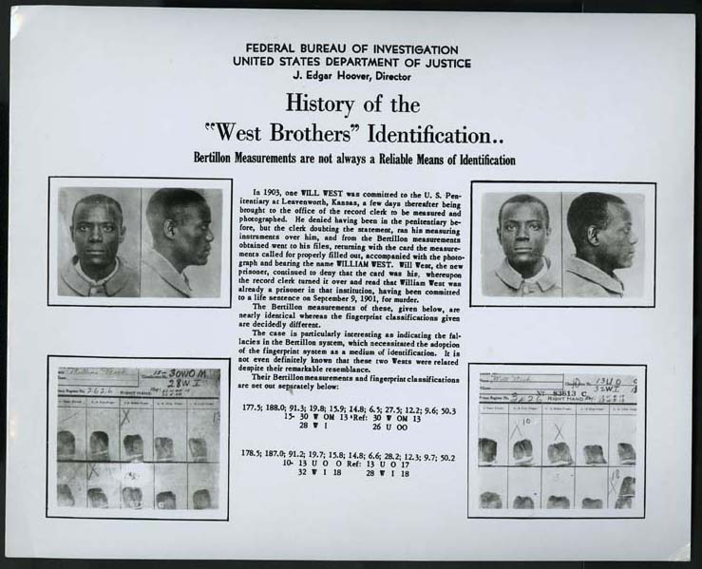
When bertillionage failed
Notes:
-Fortunately the culprit had been convicted AND fingerprints were takem.

Slide 33
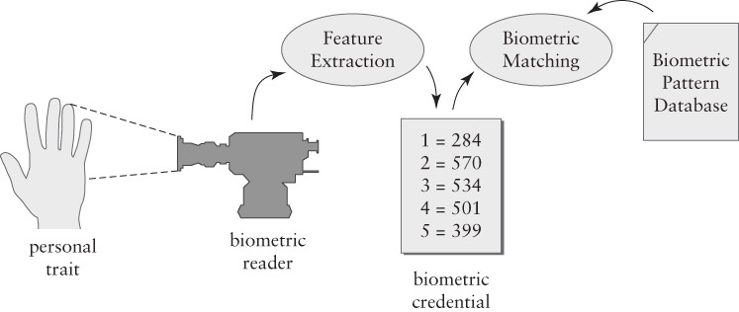
Biometrics 101

Slide 34
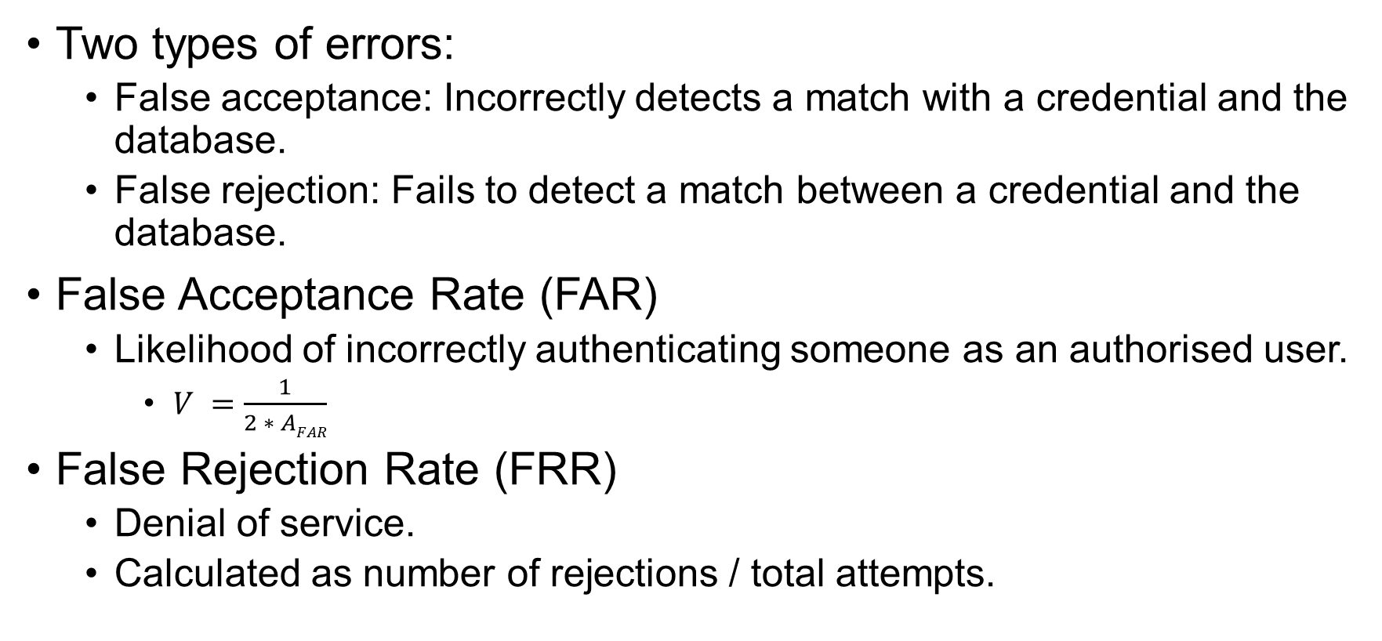
Accuracy
Two types of errors:
False acceptance: Incorrectly detects a match with a credential and the database.
False rejection: Fails to detect a match between a credential and the database.
False Acceptance Rate (FAR)
Likelihood of incorrectly authenticating someone as an authorised user.
$V =\frac{1}{2 ∗ AFAR}$
False Rejection Rate (FRR)
Denial of service.
Calculated as number of rejections / total attempts.
Notes:
-If the accuracy is 99% the FAR is 1% and AFAR is 0.01, then the average attack space is 1/(2*0.01) equal to 50.
-This would mean that one out of 50 times, we will trick the system.
-If the accuracy is 99.9% the FAR is 0.1% and AFAR is 0.001, then the average attack space is 1/(2*0.001) equal to 500.
-This would mean that one out of 500 times, we will trick the system
-Commercial applications promise accuracy of 99% or 99.9%
-This is not very impressive compared to passwords!
-Contrary to FAR, FRR depends on the actual authentication attempts.

Slide 35
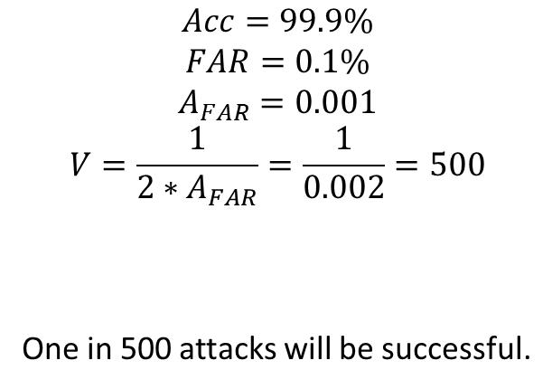
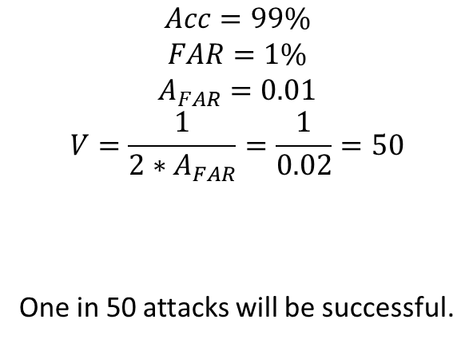
Calculation of V in biometrics
What would “99%” or “99.9%” accuracy would mean in terms of FAR and V?
$$Acc=99\%$$
$$FAR=1\%$$
$$A_{FAR}=0.01$$
$$V=\frac{1}{2∗A_{FAR}}=\frac{1}{0.02}=50$$
One in 50 attacks will be successful.
$$Acc=99.9\%$$
$$FAR=0.1\%$$
$$A_{FAR}=0.001$$
$$V=\frac{1}{2∗A_{FAR}}=\frac{1}{0.002}=500$$
One in 500 attacks will be successful.

Slide 36
Authentication Requirements
Constructing a policy for an isolated computer.
Answer these questions:
Is the computer used at home, at work, or both?
For each environment, are there threats?
Are these weak, strong or extreme threats?
Weak threat: Might make an opportunistic attack on a vulnerable computer.
Strong threat: Will spend time and effort on an attack, if unlikely to be detected and/or caught.
Extreme threat: Will take whatever is needed even with the risk of being caught.

Slide 37
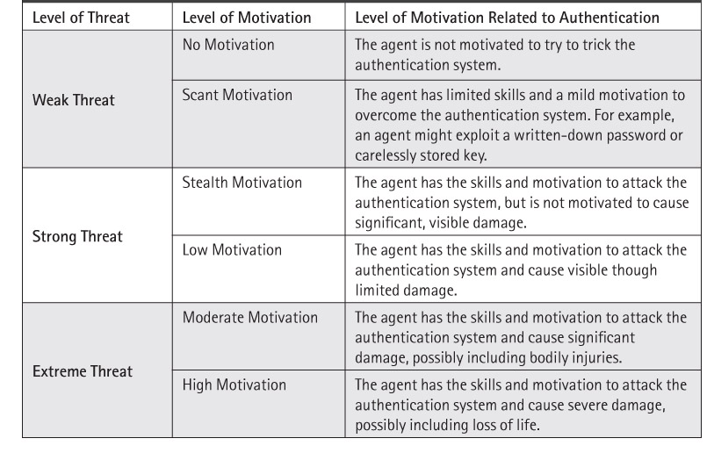
Threats and Motivations

Slide 38
Weak Threat Environments
At Home
Do not write down passwords that are at risk of being lost or stolen.
At Work
Avoid shoulder surfing.
Passwords may be written down as long as the user keeps physical possession of the list.
Authentication tokens shall be used.
Passwords should be hard to guess and easy to remember.

Slide 39
Strong Threat Environment
Using Passwords
System should track failed password guesses to try to detect guessing attacks.
Protect against keyboard sniffers.
Pick passwords that resist offline attacks.
The system should provide “secure attention”.
Other options:
Multi-factor authentication.

Slide 40
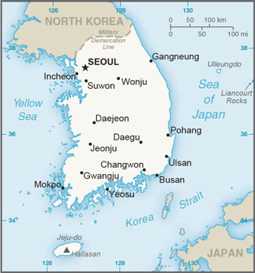

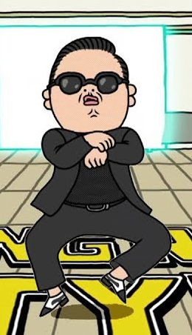

Final note

Slide 41
Lab 5: Creating Users in Linux
ADDITIONAL PRACTICE
After lab 5, try the jupyter notebooks on passwords and biometrics using Python.

